Slide 1
Key Vault – Alert Solution Design
Overview
Alerting Mechanism
Using Logic App
Leverage Key Vault provided “Events”
Event Type Uses – “SecretNearExpiry”
Prerequisites
Azure Event Grid Authentication
Authentication Options
Azure AD/Service Principal/Managed Identity
Notification Options
Outlook Authentication (One time configuration)
SMTP Server
Secret Filtration
Logic App Condition provides built-in filtrations for specific Secret to be notified
Alert Duration
Microsoft provides notification to be sent out before 30 days expiration
Notification is triggered only one time when expiry is less than 30 days
Notification
Email notification used
Logic App provides template for Email messaging
References
https://learn.microsoft.com/en-us/azure/key-vault/general/event-grid-overview

Slide 2
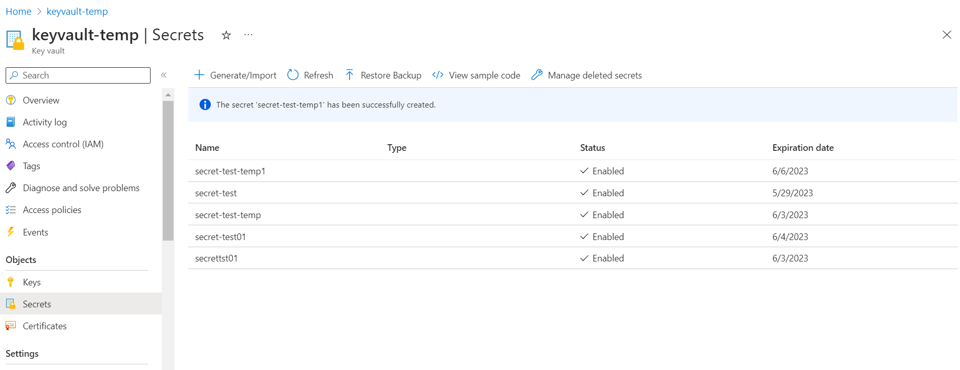
Key Vault – Secrets

Slide 3
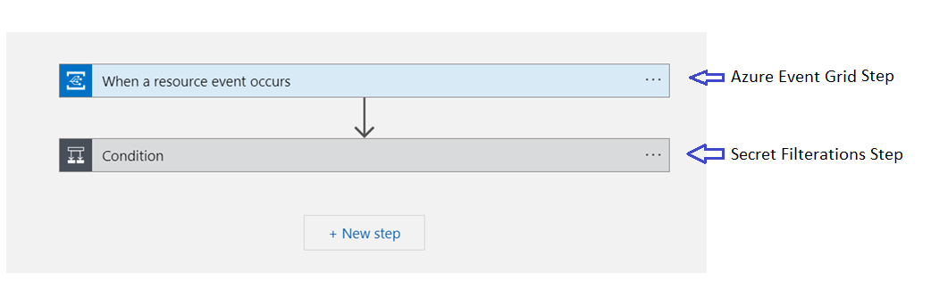
Logic App High-level Orchestration Workflow

Slide 4
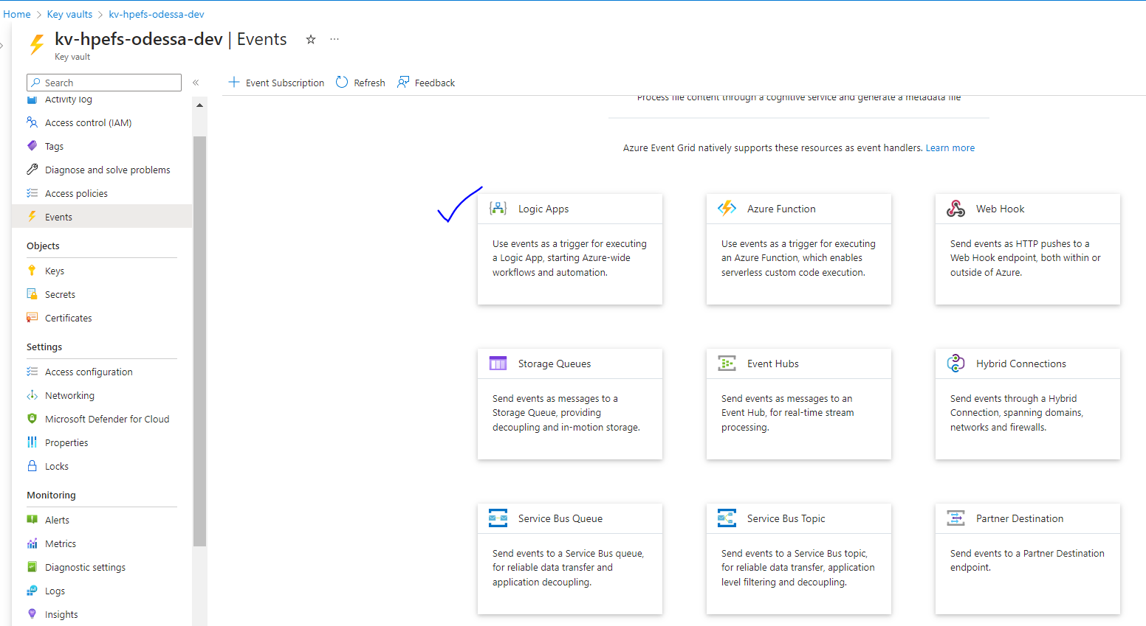
Key Vault – Events > Types
(Note – Logic Apps are created directly from here)

Slide 5
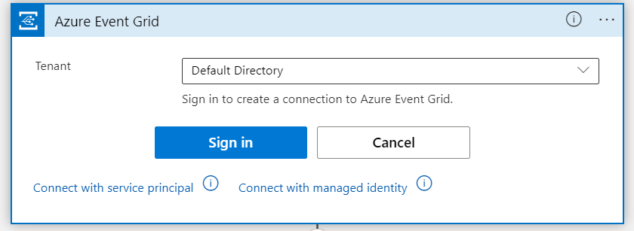
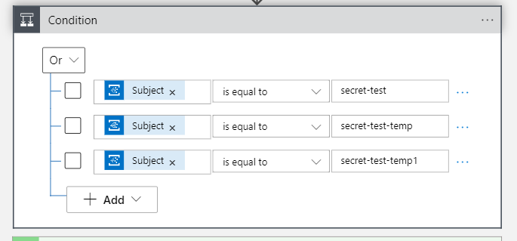
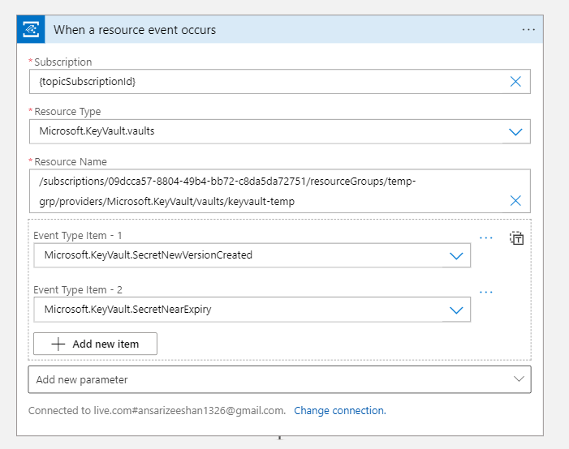
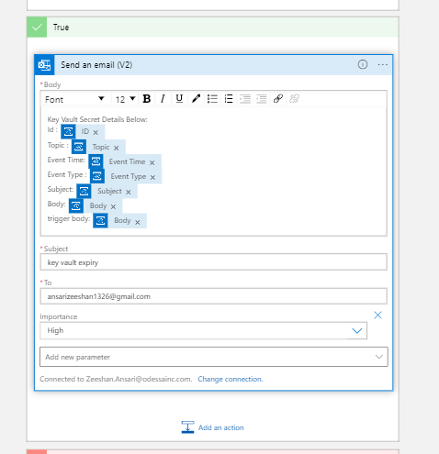
Logic App Workflow Steps

Slide 6
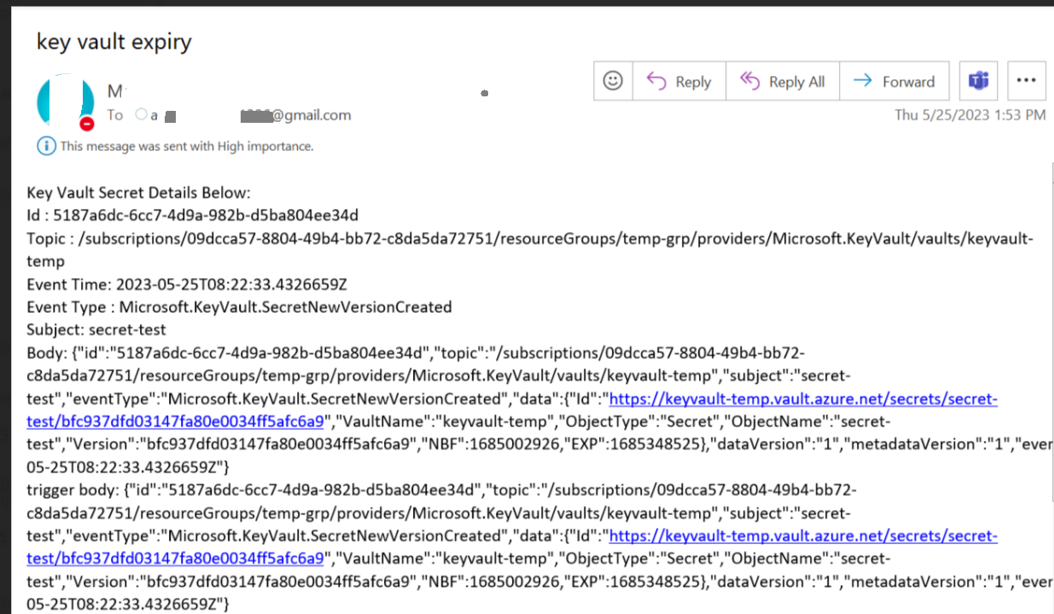
Email Notification Sample

Slide 7
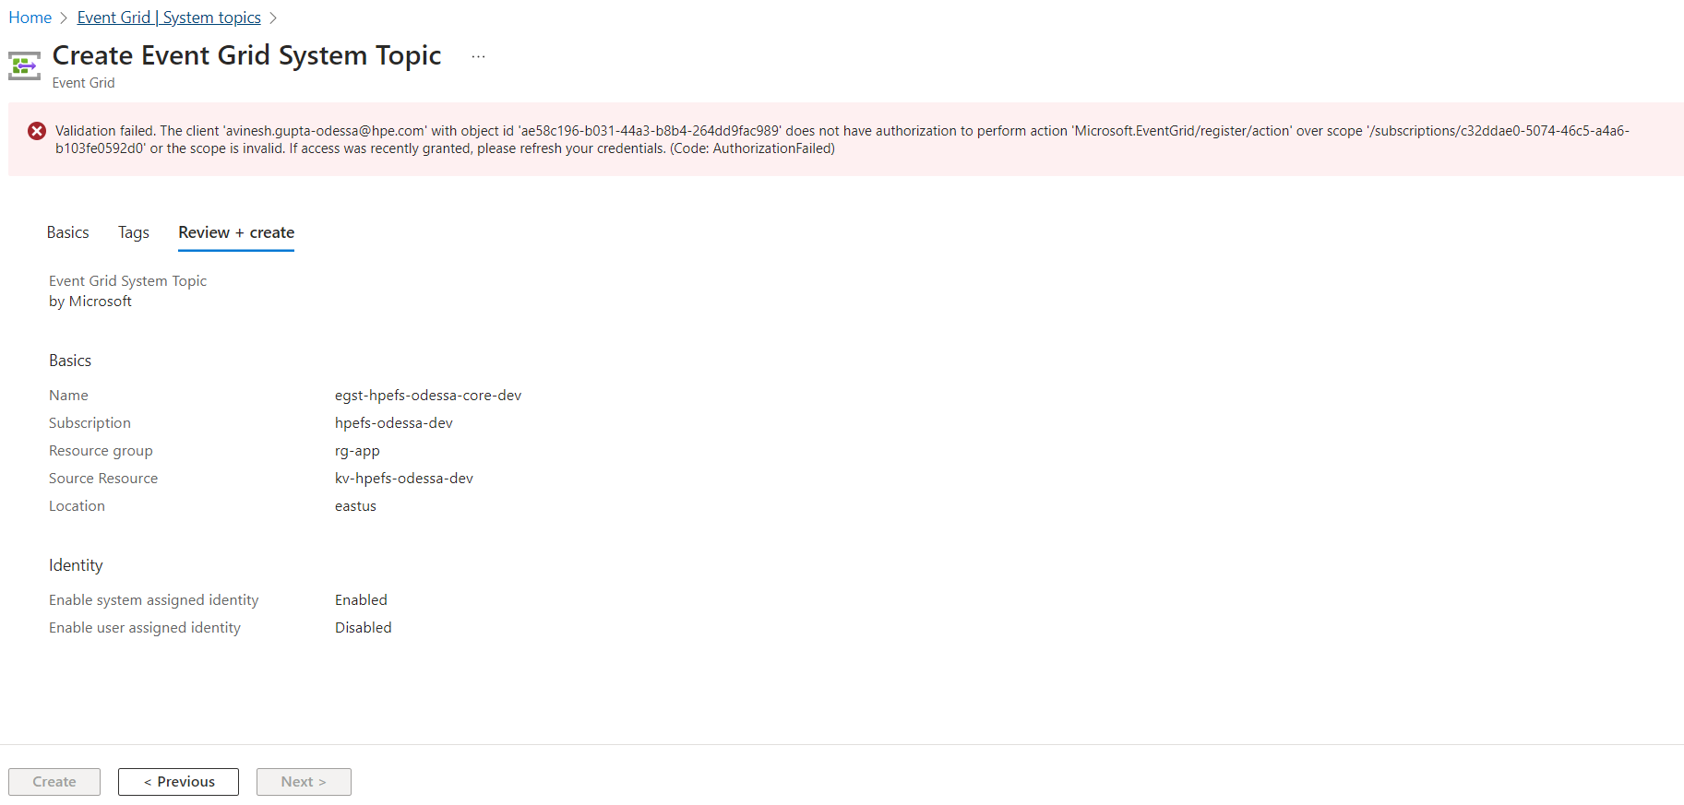
Error: Creating Event Grid System Topic

